Slide 1
WELCOME
Eastern MA USAFA Families Club, Inc.
Appointee Send-off
June 13, 2020
Notes:
Welcome & Introductions

Slide 2
For most of us, there is a lot to learn!

Slide 3
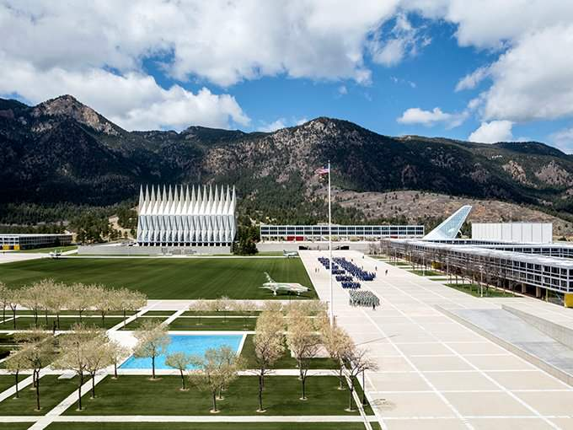
Superintendent’s Welcome to the Class of 2024

Slide 4
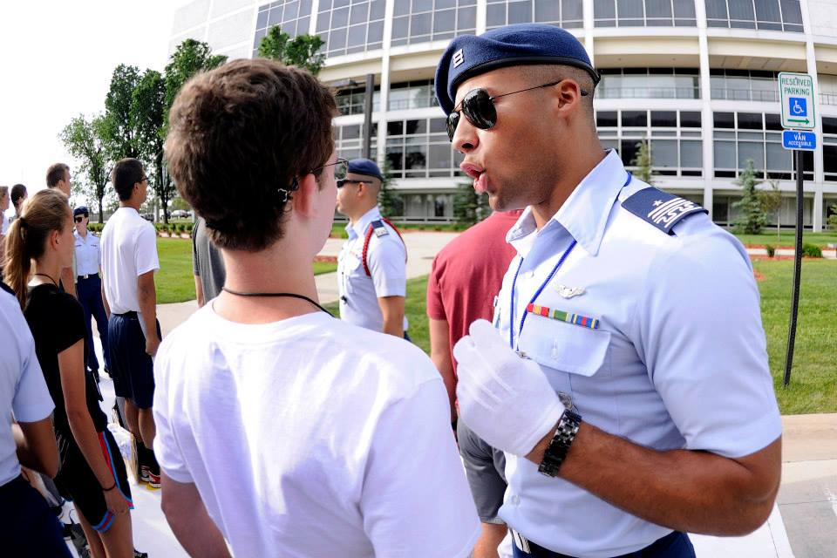
Parenting a cadet
Stressful environment ~ purposeful. Ultimately soldiers, marines, airmen, and sailors are warriors and must learn to function in war time in a stressful environment, while making good decisions and leading others. That training starts Day 1 on The Bus and at Footprints.

Slide 5
Initially, limited exposure to home, family & friends ~ Purposeful.
The AFA wants cadets to learn to be dependent on only themselves and on their classmates. They are the ones they will eat with, live with, train with, and eventually face combat with. Family and friends are important, but their new friends will take on the #1 role in their lives. By the end of Day 2, they will have a grasp of just how important their classmates will be to their success. No “individual” can succeed at the AFA. Success depends on teamwork.

Slide 6
One day they love it, the next they may hate it and will tell you so during a phone call. By the next day, they are over it while you fret for a week– that is normal.

Slide 7
Words of advice from General Mark Welsh III who has “been there and done that” as a cadet and a USAFA parent:
Former Chief of Staff of the US Air Force;
Commander, US Air Forces Europe; Commander, Air Component Command, Ramstein AFB; and Director, Joint Air Power Competence Center, Ramstein AFB, Germany
AFA Graduate ~ Class of 1976
A-10 & F-16 pilot
AFA Air Officer Commanding, Cadet Squadron 5 ~ 1984 - 1985
Executive Officer to AFA Commandant ~ 1985 - 1987
F-16 Fighter Wing Commander, first Gulf War
AFA Commandant 1999 ~ 2001
AFA Cadet Parent (son John, AFA Class of 2003)

Slide 8
General Welsh:
“You did a great job getting them here. They are here because they measure up in every way for what we want in an officer and leader. Now it’s our job to teach them to transition to the role of officer and leader in our Air Force.”
“Your job now is to be a supporter and their biggest cheerleader.”
“When they tell you they’re going to jump out of a perfectly good airplane and parachute to earth, you need to say, “Man that’s great!””

Slide 9
“When they tell you that after a lot of thought, they’ve decided to change their major and tell you why, that’s your cue for, “I can understand why you would make that choice.””
“If they tell you they’re going to fly a plane with no motor and do loops and spins over the Front Range of the Rockies, your response should be, “I wish I could be there to watch.””

Slide 10
Some DOs & Some DON’Ts
The DOs:
Be a listener, supporter, encourager first and foremost.
Help them to focus on the task at hand for that day, that week and that semester, not the trip home at Thanksgiving.

Slide 11
Expect days when they say “this is tough and I’m not sure I belong here” (the ‘ugly letter’ during BCT). Remember that for many appointees, at their high school they were one of the top academic students, top athletes, and most popular students. The reality now is that their 1,000+ classmates are just like them! For some, that is a major adjustment.

Slide 12
Remind them to focus on why they wanted to attend the AFA and that they were selected because the AFA determined they had the “Right Stuff” to make it. They were the 1 in 10 the AFA felt would succeed.
Support THEIR decision making!

Slide 13
The DON’Ts:
Don’t initiate the questions when you speak with your cadet. Let THEM talk and tell you what they are doing first.
Don’t be a “helicopter parent.” The last thing a cadet needs is a hovering parent. They need encouragement, support, & independence.

Slide 14
DON’T CALL THE ACADEMY!
This is not high school. The AFA wants cadets to learn to be leaders which is why it is called a “Leadership Laboratory.”
Leadership comes from learning to take the initiative. The AFA will present your cadet with all the tools necessary to succeed – academically, militarily, physically, etc. They have to learn to take advantage of those tools to survive and to be successful.
It is their job to take the initiative, not yours.

Slide 15
What to expect during BCT

Slide 16
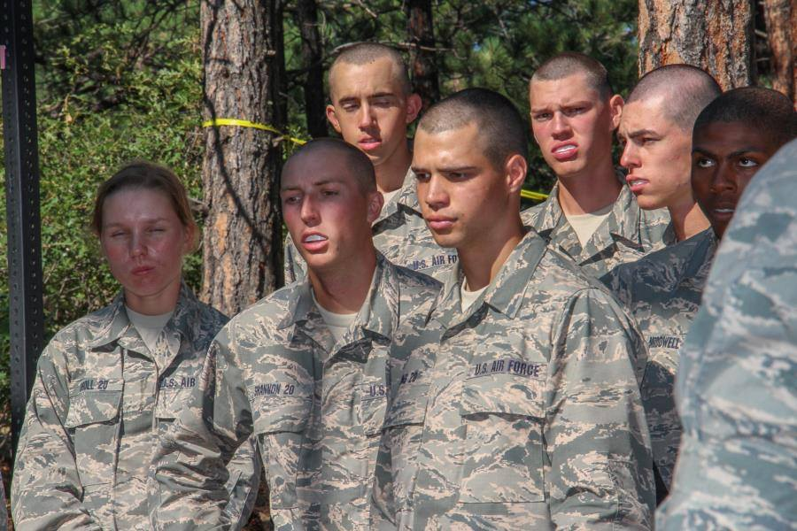
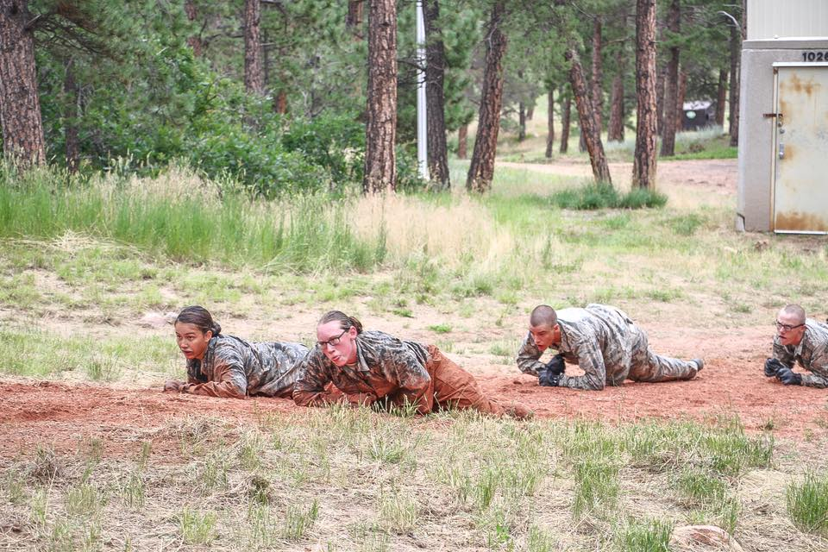
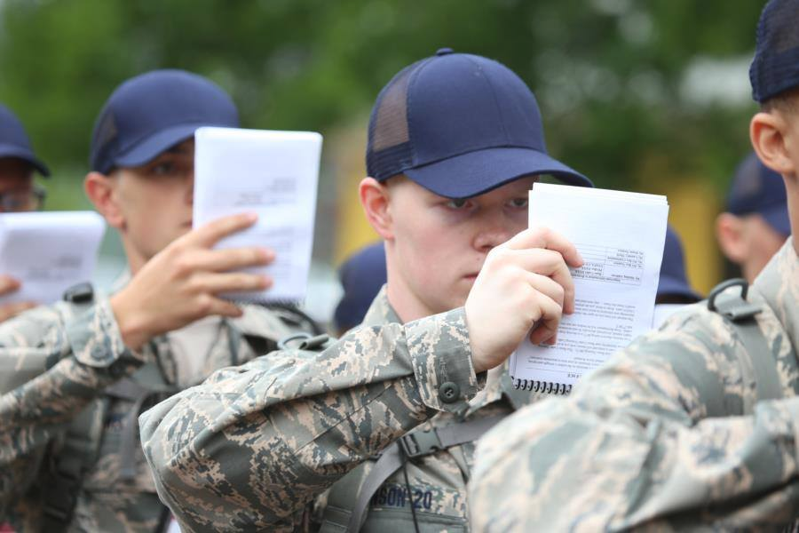
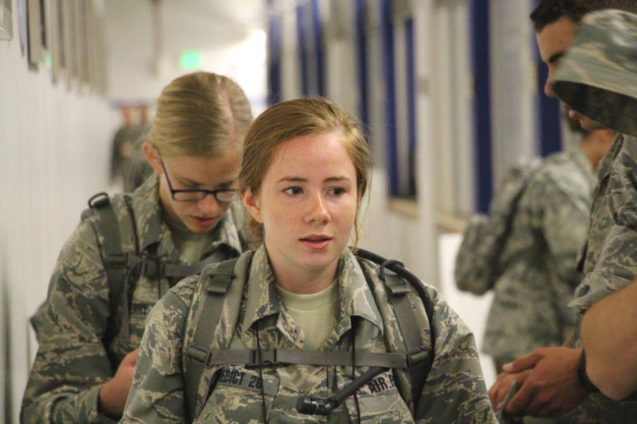
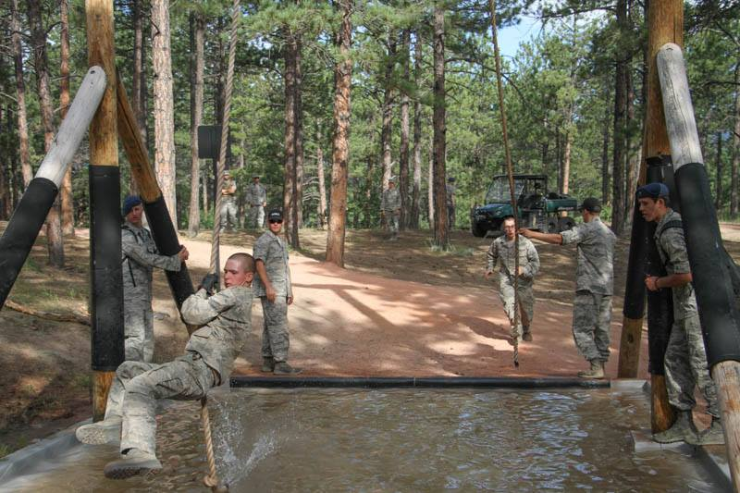
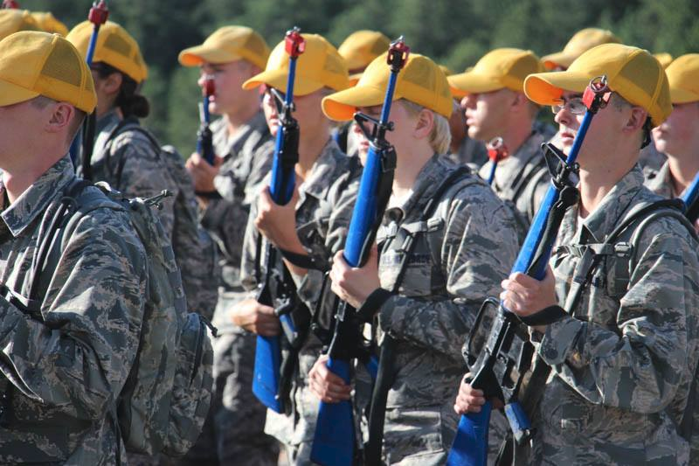

Slide 17
Very little communication other than letters
Your job is to write as often as possible. Letters don’t have to be long – include newspaper articles of interest, funny stuff found online, printed and sent, etc…. anything that brings a smile.
Get friends and family to write as well.

Slide 18
A WORD OF CAUTION ABOUT LETTERS!
DO NOT send:
Colorful envelopes
Hearts and kisses
Scented envelopes
Pictures
Anything embarrassing

Slide 19
Try to avoid the “We miss you” letters. Instead use “Looking forward to seeing you at “Parents’ Weekend” instead.
Their letters will be brief! They will be busy from sun-up to lights-out, and they WILL need their rest.

Slide 20
After BCT, they return to the AFA and have just a few days before the entire wing returns, then suddenly they go from knowing their Cadre with whom they are familiar, to facing 3,000+ upperclassmen.
Can you say “overwhelming?” Again, they need to adjust, adapt, and move on.

Slide 21
And again, your job is to support and encourage them

Slide 22
What To Expect The First Year

Slide 23
The C4C year is all about constant adjustments. Until Recognition in the Spring, they will constantly have to be on their toes, never, ever truly feeling completely comfortable.
Again, this is all purposeful.

Slide 24
They’ll complain about the constant memorization and why they need to do it. That’s because in the AF, it is a necessary skill. When a pilot is making a landing and an engine flames out, there’s no time to pull out the manual and look in the index for “Steps to follow for Engine Flameout while on approach.” It has to be a reaction that is all by the numbers, or survivability is almost zero.

Slide 25
Nothing your son or daughter will do is like anything that other college students will do. Their friends won’t be taking 6 or 7 courses per semester over 4 years. Their friends also won’t have to memorize military knowledge; won’t have to pass a PFT, AFT, or participate in mandatory intramurals; won’t have room inspections, get hair cuts, wear a uniform; and won’t march to lunch.

Slide 26
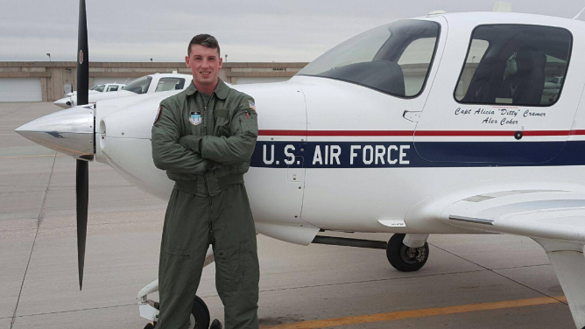
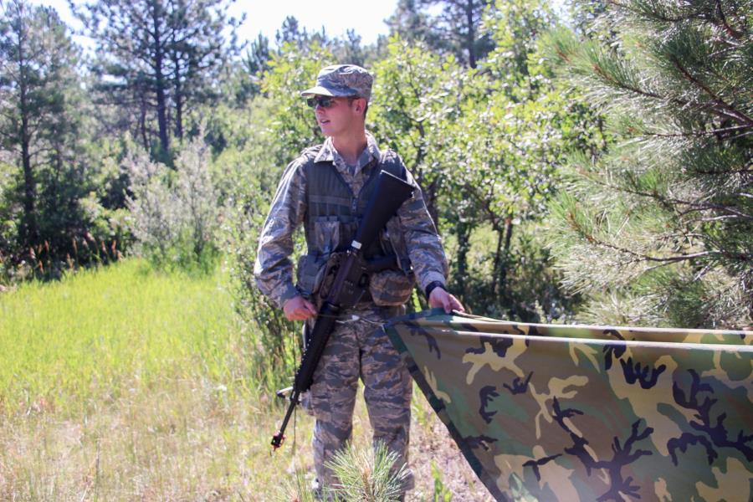
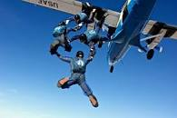
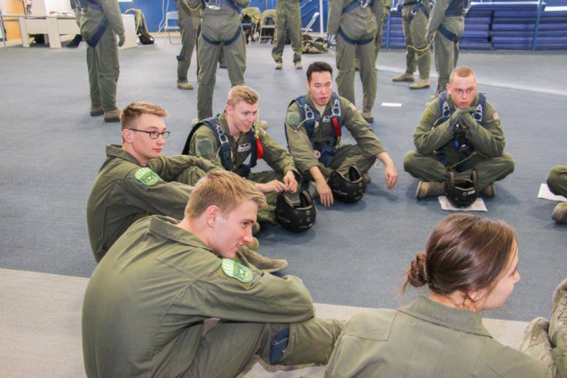
However, neither will their friends get to fly a glider, parachute, spend 3 weeks in the summer in Japan at a fighter base, work an internship at the Pentagon, or teach other cadets how to fly or to jump….

Slide 27
What your cadet will get is one extraordinary education that won’t be duplicated anywhere else in the world, but it’s no trip to “Six Flags” to successfully complete these four years.

Slide 28
Some say, “If a cadet tells you they ‘Love the AFA.’ You might want to give them some space, because no one ‘loves’ the AFA.”
Cadets will usually tell you they “like the AFA as much as a cadet can.” I think you’d have to have been a cadet to fully understand that statement, but you get the drift.

Slide 29
This is one very special time in their lives and yours, and we hope that you will enjoy it with them as much as all of us have here in this room with our cadets and/or grads.
Eventually, in what will seem like 4 months and not 4 years, they will be rewarded with this view:

Slide 30
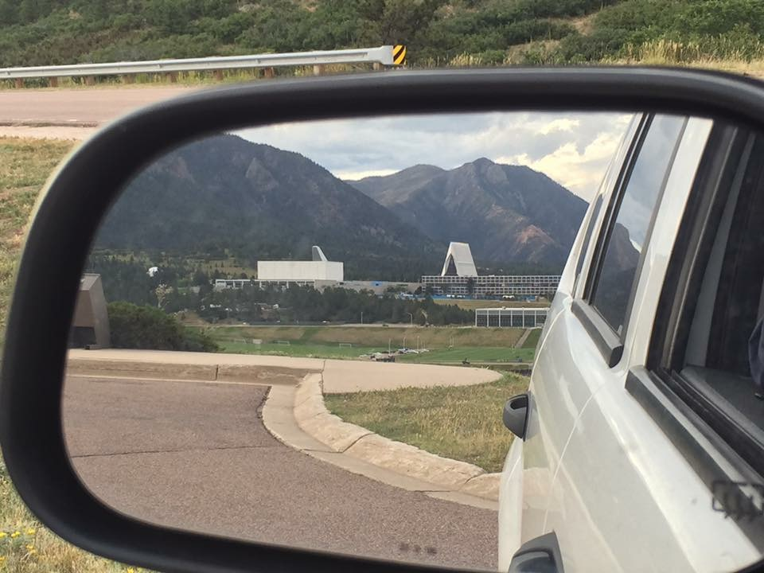

Slide 31
Things You Should Be Doing
In-processing ~ Any parents planning to drop off?
Acceptance Day ~ Virtual Event?
Parents’ Weekend ~ Still being discussed by leadership
Reviewing the resources in your notebook
Notes:
Put parents together for ex. New parents going to in-processing with parents who have gone.

Slide 32
Ways to keep in touch with your Cadet during Basic:
1. Webguy: www.usafawebguy.com
2. Letters from home

Slide 33
Eastern MA USAFA Families Club, Inc.
Our parents’ club has 4 Simple Objectives:
Support each other
Support our Cadets and Graduates
Support the AFA
Support our USAF

Slide 34
How We Operate
Year-Round Activities
One-time lifetime dues
Donations
Fundraising (Keepsake sales)
Adopt an Appointee Program

Slide 35
Our Events
3 meetings during the academic year –
January, April/May, December featuring AFA-related speakers
2 events during the summer - Appointee Send-off &
Cookout
Parents’ Weekend - Football game
2 events with the New Eng Assoc of Grad (NEAOG)
Fall ~ State of the Wing Dinner
Spring ~ Academy Night
All Service Academies Holly Ball - December

Slide 36
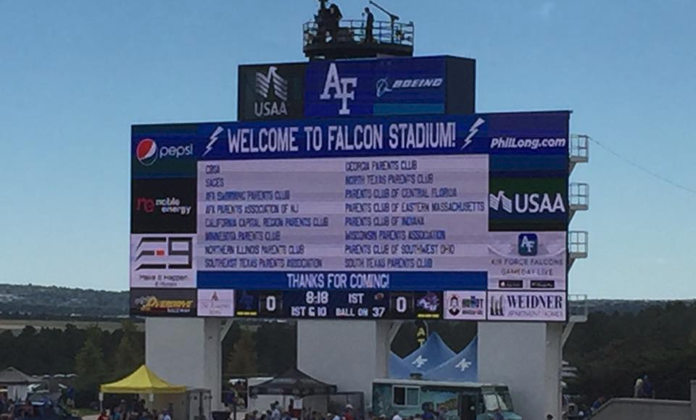
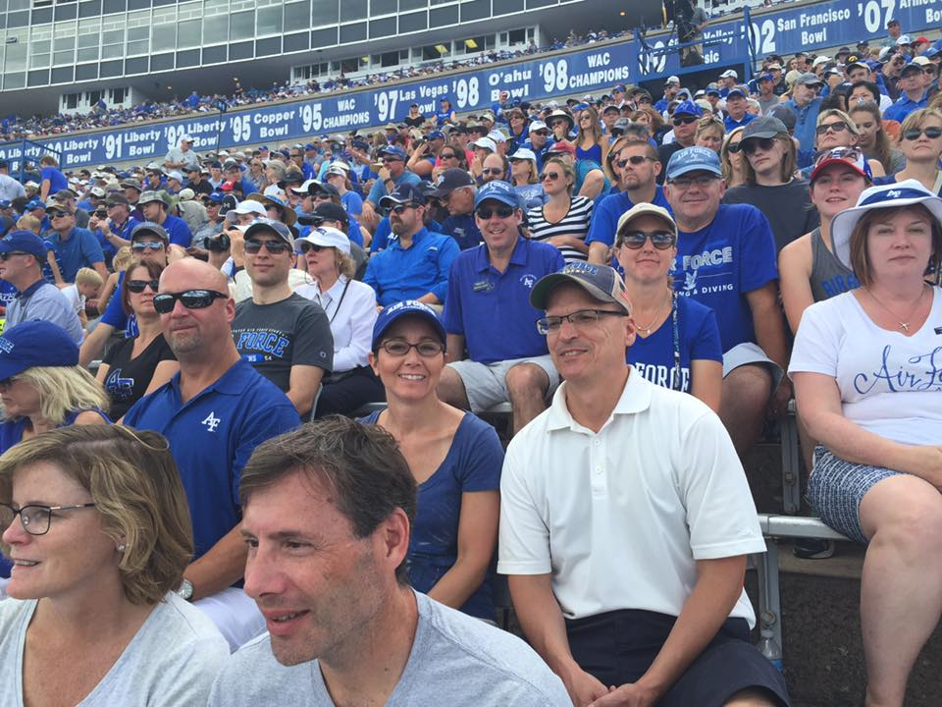
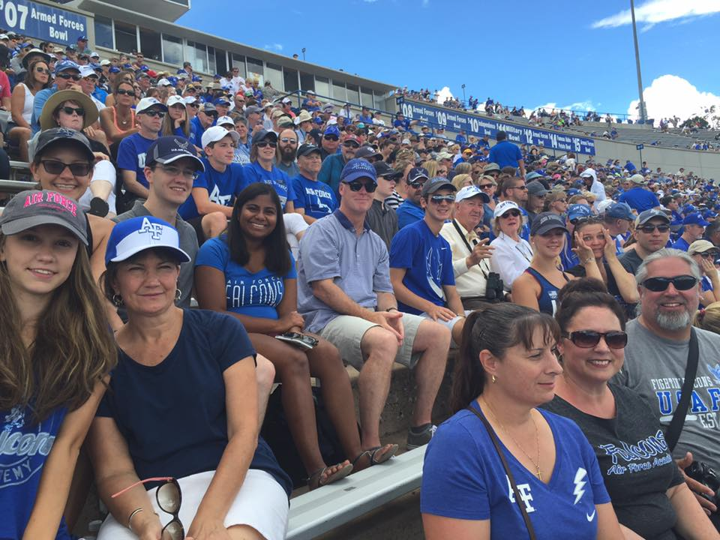
Parents’ Weekend

Slide 37
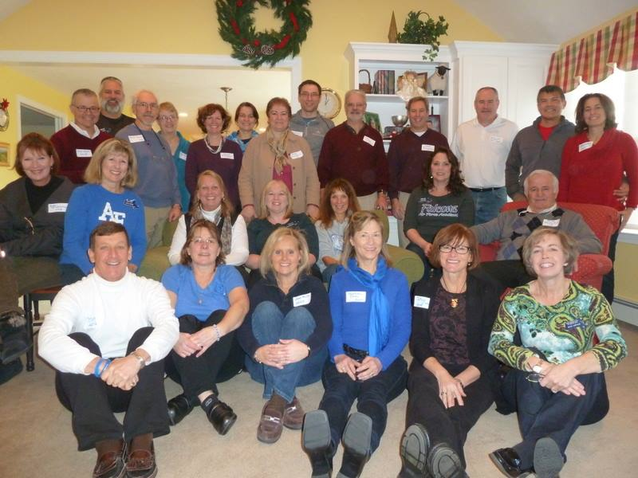
Cookie Wrap

Slide 38
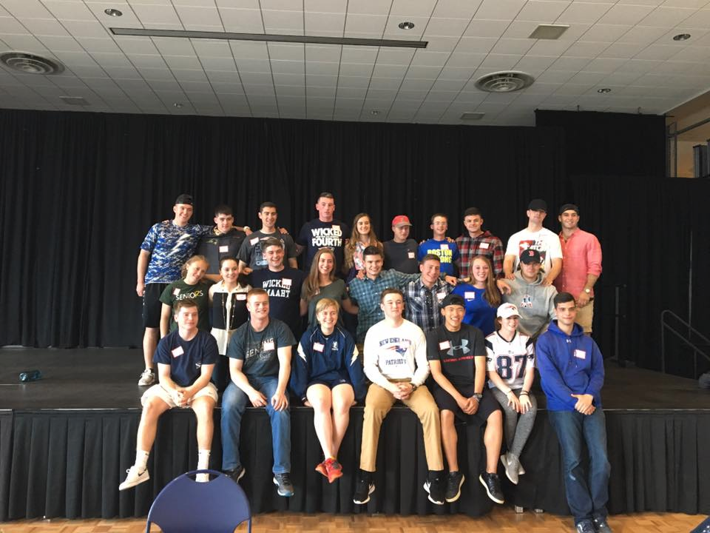
Eastern MA Night at USAFA

Slide 39
We invite you to become members and participate along with us. We guarantee you will enjoy the AFA experience more if you can share it with friends who relate to what you are experiencing.

Slide 40
Why Join?
Learn from current members and pay forward to future families.
Be part of tradition.
The Academy HIGHLY recommends participation and has an office dedicated to USAFA parents’ associations across the country.
Develop close bonds with others sharing this unique experience.

Slide 41
Thank You
The Club Officers: Past and Present
Our USAFA Cadet speakers!
All of you for making this parents’ club grow!

Slide 42
Dates You Need To Know for 2020
25 June In-processing, Class of 2024
26 June Swearing-In Ceremony - 1st BCT
11 July Pikes Peak or Bust Rodeo
12 July Basics’ Phone Call Home
TBD July EMA Club Cookout
17 July March Out to Jacks Valley - 2nd BCT
26 July March Back from Jacks Valley
31 July BCT Graduation
1 Aug Doolie Day Out
4 August Acceptance Day Parade
6 August Classes Begin
4-7 Sept Parents’ Weekend
TBD December EMA Club Cookie Wrap& Meeting
7-11 December 1st Semester Finals

Slide 43
Parents, we’ll see you at the annual Eastern MA USAFA Club Cookout in July.
Date and reminders to come!

Slide 44
Lean on us!
That is what we are here for!

